Slide 1

STUDENT NAME:NIMMATHI DEVI A
REGISTER NO AND NMID: 24bca081
91D0442078DA4EB3BB1AA4B5B6D0DEA21E
DEPARTMENT: BCA Computer application COLLEGE: Mohamed Sathak College of Arts and Science
1

Slide 2

PROJECT TITLE
DIGITAL
PORTFOLIO
1

Slide 3



AGENDA
1. Problem Statement 2.Project Overview 3. End Users 4.Tools and Technologies 5.Portfolio designand
Layout
6.Features and
Functionality
7.Results andScreenshots 8. Conclusion 9.Github Link
3/21/2024Annual Review
1

Slide 4


PROBLEM STATEMENT
In today’s competitive digital world, individuals lack a centralized, professional, and visually appealing platform to showcase their academic achievements, skills, and projects. A digital portfolio is necessary to present personal and professional information effectively.
1

Slide 5

PROJECT OVERVIEW
TheDigital Portfolio Websiteis a personal platform
designed to highlight academic, technical, and creative skills. It contains sections such as About Me, Education, Projects, Skills, Certifications, and Contact information. The website is responsive, user-friendly, and customizable.
1

Slide 6
WHO ARE THE END USERS?
Students – Showcase academic achievements and skills Job Seekers – Highlight projects and certifications Professionals – Build an online personal brand Recruiters/Employers – View candidate portfolios easily
1

Slide 7


TOOLS AND TECHNIQUES
Frontend: HTML, CSS,JavaScript, Bootstrap
Backend: Python (Flask/Django) or PHP (if
required)
Database: MySQL / SQLite (optional)
Hosting: GitHub Pages / Netlify
Version Control: Git & GitHub
1

Slide 8

POTFOLIO DESIGN AND LAYOUT
The design and professionallayoutwith
follows a clean, minimal,
proper
navigation. Sections
include:Home,
About, Projects, Contact. The portfolio
Skills,
Education, Certifications,
and
is responsivefor
both
desktop and mobiledevices.
1

Slide 9
FEATURES AND FUNCTIONALITY
User-friendly interface withsmooth navigation
Responsive design for mobile and desktop
Sections for About, Projects, Skills, and Contact
Integration with LinkedIn/GitHub
Downloadable Resume option

Slide 10
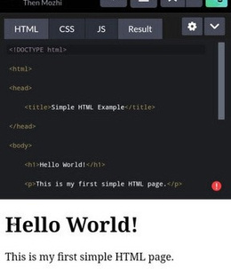
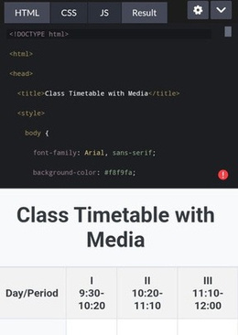

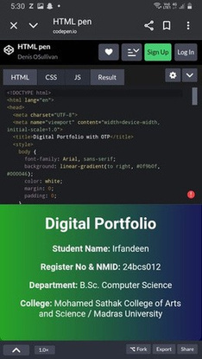
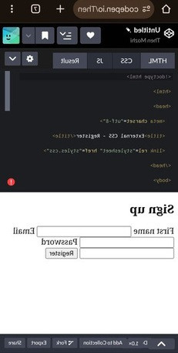
RESULTS AND SCREENSHOTS
3/21/2024Annual Review
10

Slide 11
CONCLUSION
The DigitalPortfolio
Website providesan
organized and professional wayto present personalachievements,skills, and projects. It enhances
careeropportunities a strongdigitalpresence
and
creates
10

